Slide 1

OBJECT ORIENTED MODELLING & DESIGN (OOMD)
SOFTWARE TESTING
UE19CS400SB
Prof. Venkatesh Prasad/Ms.Sumy Joseph
venkateshprasad@pes.edu
Department of Computer Science & Engineering

Slide 2
Contents
Classification of Testing types based on methods/ Requirements/target/needs

Slide 3
Why Testing Important?
Software testing is the process of evaluating and verifying that a software product or application does what it is supposed to do.
The benefits of testing include preventing bugs, reducing development costs and improving performance.
The testing is important since it discovers defects/bugs before the delivery to the client, which guarantees the quality of the software.
It makes the software more reliable and easy to use.
Thoroughly tested software ensures reliable and high-performance software operation.

Slide 4
Testing
Testing in Software Engineering
As per ANSI/IEEE 1059, Testing in Software Engineering is a process of evaluating a software product to find whether the current software product meets the required conditions or not.
The testing process involves evaluating the features of the software product for requirements in terms of any missing requirements, bugs or errors, security, reliability and performance.
Types of Software Testing
Functional Testing
Non-Functional Testing or Performance Testing
Maintenance (Regression and Maintenance)

Slide 5
STLC-SOFTWARE TEST LIFE CYCLE
What is Software Testing Life Cycle (STLC)?
Software Testing Life Cycle (STLC) is a process used to test software and ensure that quality standards are met.
Tests are carried out systematically over several phases.
Software Testing Life Cycle (STLC) is a sequence of specific activities conducted during the testing process to ensure software quality goals are met.
STLC involves both verification and validation activities.

Slide 6
STLC Phases
There are following six major phases in every Software Testing Life Cycle Model (STLC Model):
Requirement Analysis
Test Planning
Test case development
Test Environment setup
Test Execution
Test Cycle closure

Slide 7
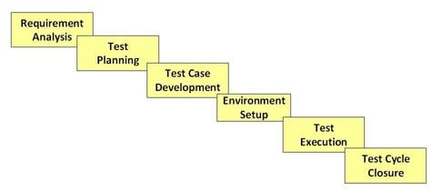
STLC

Slide 8
What is Entry and Exit Criteria in STLC?
Entry Criteria: Entry Criteria gives the prerequisite items that must be completed before testing can begin.
Exit Criteria: Exit Criteria defines the items that must be completed before testing can be concluded

Slide 9
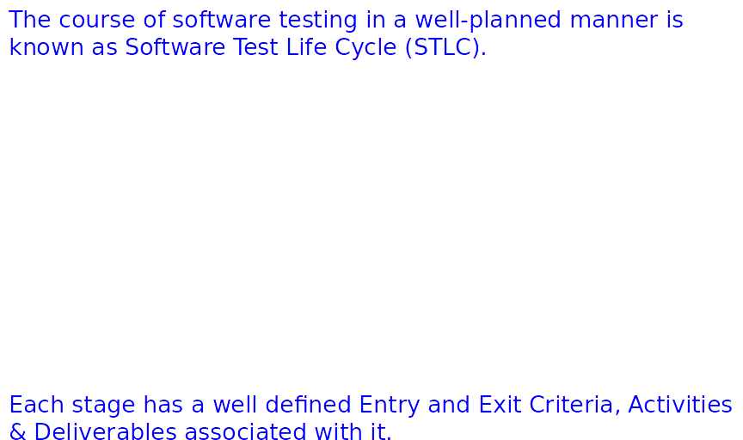
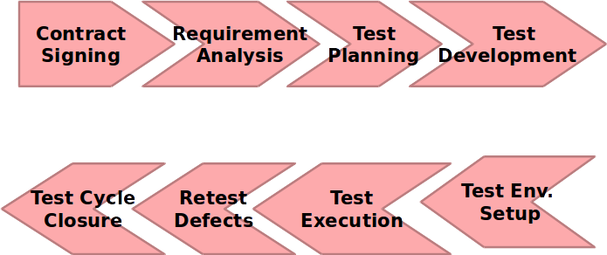
Software Test Life Cycle

Slide 10
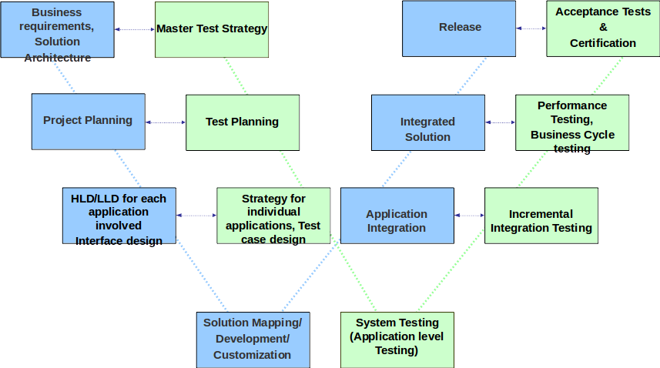
Detailed Test Life Cycle – V&V (or W) Process Model

Slide 11
STLC PHASES
1. Requirement Phase Testing
Requirement Phase Testing also known as Requirement Analysis in which test team studies the requirements from a testing point of view to identify testable requirements and the QA team may interact with various stakeholders to understand requirements in detail.
Activities in Requirement Phase Testing
Identify types of tests to be performed.
Gather details about testing priorities and focus.
Prepare Requirement Traceability Matrix (RTM).
Identify test environment details where testing is supposed to be carried out.
Automation feasibility analysis (if required).
Deliverables of Requirement Phase Testing
RTM
Automation feasibility report. (if applicable)

Slide 12
2. TEST PLAN
Test Planning in STLC is a phase in which a Senior QA manager determines the test plan strategy along with efforts and cost estimates for the project.
Moreover, the resources, test environment, test limitations and the testing schedule are also determined.

Slide 13
Test Planning in STLC
Test Planning Activities
Preparation of test plan/strategy document for various types of testing
Test tool selection
Test effort estimation
Resource planning and determining roles and responsibilities.
Training requirement
Deliverables of Test Planning
Test plan /strategy document.
Effort estimation document.

Slide 14
3. Test Case Development Phase
The Test Case Development Phase involves the creation, verification and rework of test cases & test scripts after the test plan is ready.
Test Case Development Activities
Create test cases, automation scripts (if applicable)
Review and baseline test cases and scripts
Create test data (If Test Environment is available)
Deliverables of Test Case Development
Test cases/scripts
Test data

Slide 15
4. Test Environment Setup
Test Environment Setup decides the software and hardware conditions under which a work product is tested.
It is one of the critical aspects of the testing process and can be done in parallel with the Test Case Development Phase.
Test Environment Setup Activities
Understand the required architecture, environment set-up and prepare hardware and software requirement list for the Test Environment.
Setup test Environment and test data
Perform smoke test on the build
Deliverables of Test Environment Setup
Environment ready with test data set up
Smoke Test Results.

Slide 16
5. Test Execution Phase
Test Execution Phase is carried out by the testers in which testing of the software build is done based on test plans and test cases prepared.
Test Execution Activities
Execute tests as per plan
Document test results, and log defects for failed cases
Map defects to test cases in RTM
Retest the Defect fixes
Track the defects to closure
Deliverables of Test Execution
Completed RTM with the execution status
Test cases updated with results
Defect reports

Slide 17
6. Test Cycle Closure
Test Cycle Closure phase is completion of test execution which involves several activities like test completion reporting, collection of test completion matrices and test results.
Testing team members meet, discuss and analyze testing artifacts to identify strategies that have to be implemented in future, taking lessons from current test cycle.
Test Cycle Closure Activities
Evaluate cycle completion criteria based on Time, Test coverage, Cost,Software, Critical Business Objectives, Quality
Prepare test metrics based on the above parameters.
Document the learning out of the project
Prepare Test closure report
Test result analysis to find out the defect distribution by type and severity.
Deliverables of Test Cycle Closure
Test Closure report
Test metrics

Slide 18
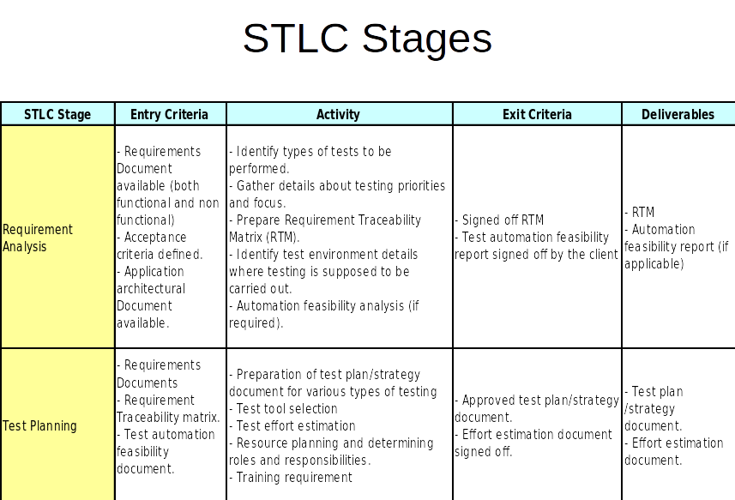

Slide 19
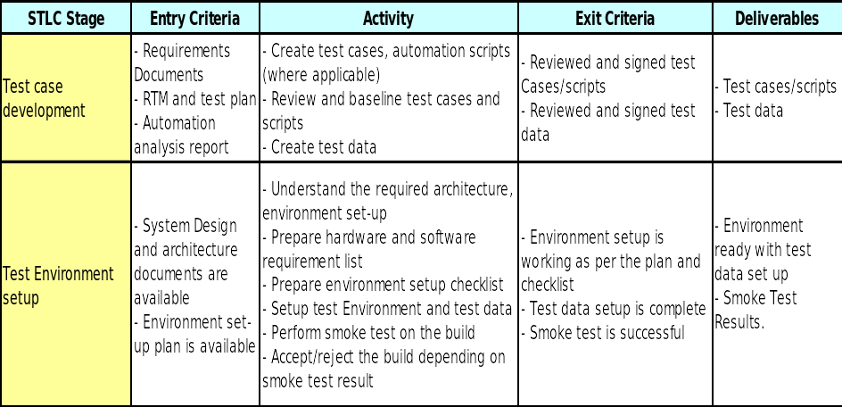

Slide 20
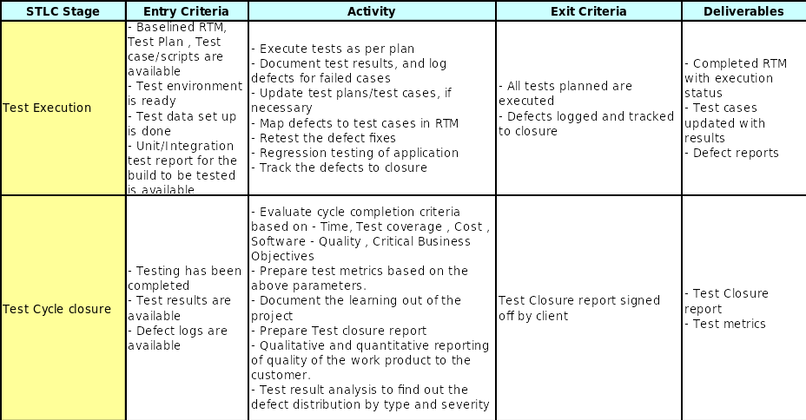

Slide 21
SOFTWARE TESTING TYPES

Slide 22
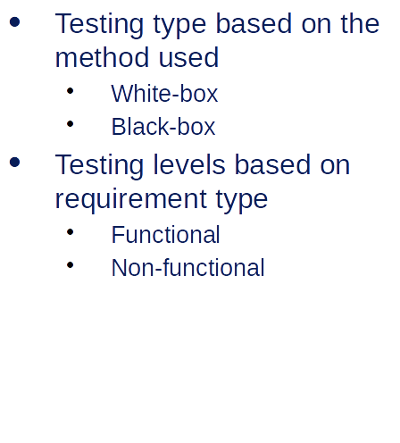
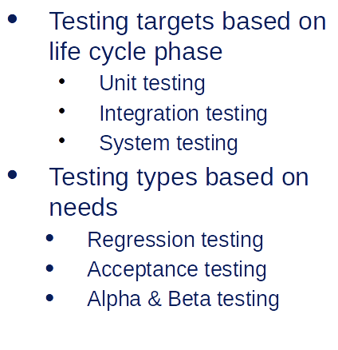
Types of Testing

Slide 23
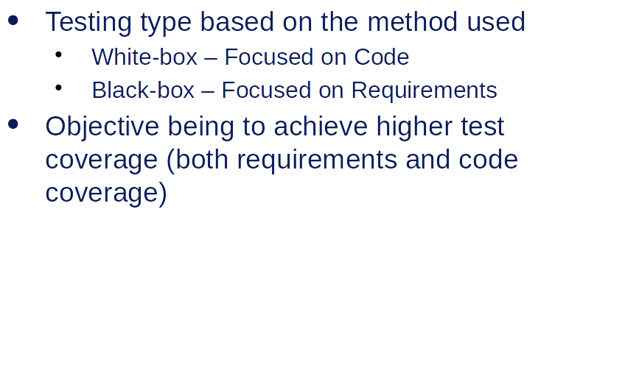
Types of Testing - Based on method used

Slide 24
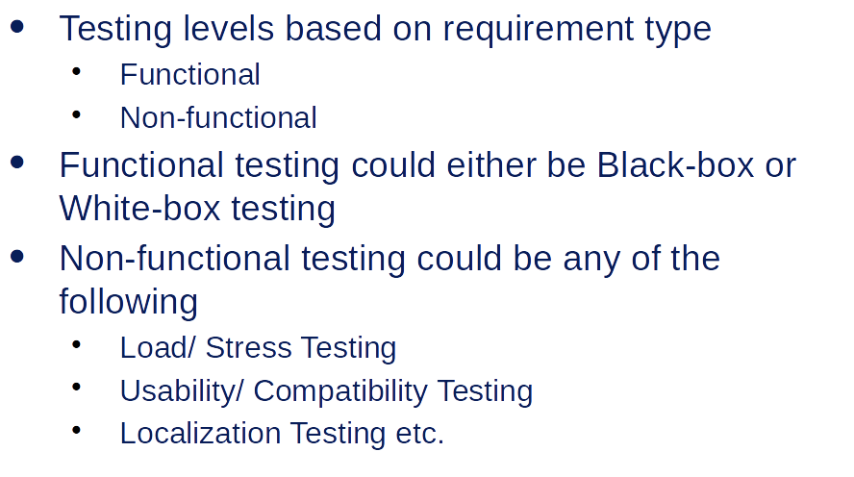
Types of Testing - Based on Requirement type

Slide 25
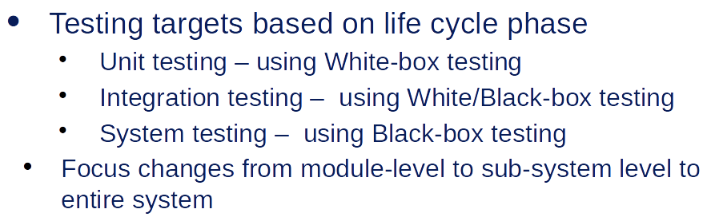
Types of Testing - Based on life cycle phase

Slide 26
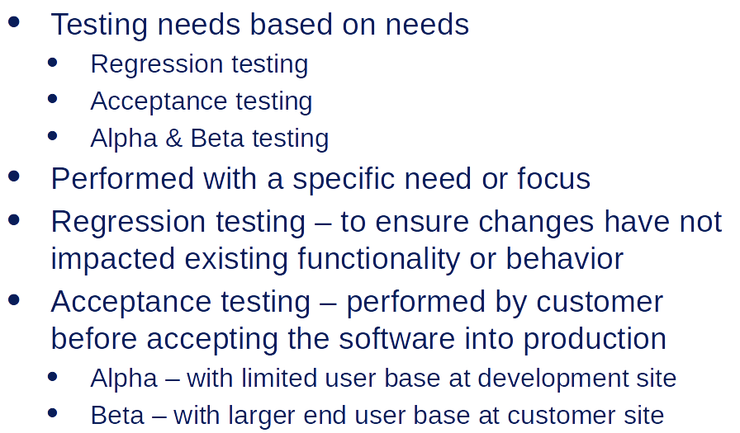
Types of Testing - Based on needs

